Slide 1
Targeted Proteomics in Skyline: Experimental Design, Method Development, and Statistical Analysis
Northeastern University
May 1-3, 2017
Brendan MacLean, Lindsay Pino, Susan Abbatiello

Slide 2
Goals and Concepts Day 1
Set up a targeted LC-MS/MS method
Empirical data vs. information from literature
Skyline
Refine and optimize method
Peptide selection and transition refinement
MS settings and LC conditions
iRT

Slide 3
Goals and Concepts Day 2
Absolute Quantitation and Method Validation
Appropriate experimental design
Internal standards
Calibration curves
Appropriate design and execution
Statistical analysis, LOD/LOQ calculations
Peptide Stability
Method Reproducibility
Method Repeatibility

Slide 4
Goals and Concepts Day 3
System Suitability
Method design
Analyte selection
Data evaluation
AutoQC

Slide 5
Instructors
Brendan MacLean
Lindsay Pino
Susan Abbatiello
D. R. Mani
Cyril Galitzine

Slide 6
Designing a Targeted LC-MS/MS Method for High Confidence Peptide Quantitation
Susan Abbatiello
Northeastern University Skyline Short Course
May 1, 2017

Slide 7


Current Application of LC-MS for Discovery of Biomarkers
10’s
Samples
100’s
Samples
1000’s
Samples
> 10,000
Analytes
100’s
Analytes
4 - 10
Analytes
Bio-Specimens
Plasma
Tissue
Proximal fluids
Discovery
Tissue
Proximal fluids
Verification
Blood
Population
Clinical
Validation
Blood
Population
biomarker
candidates
Found in blood?
higher in cancer?
Biomarkers worth
evaluating
untargeted proteomics
genomics
“hypotheses”
Adapted from Rifai, Gillette and Carr Nat. Biotech.2006

Slide 8
Overview
Considerations for Designing Targeted Experiments
Quantitation by MS?!?!
Mass Analyzers
Evaluating your data

Slide 9

What are your goals?
Detection
Quantitation
- Or -
Present
Not Detected
Precision/Reproducibility
Limit of Detection (LOD)
Accuracy
Precision/Reproducibility
Linearity
Lower Limit of Quantitation (LLOQ)
Upper Limit of Quantitation (ULOQ)

Slide 10



Considerations in Developing Targeted Assay
Why was protein candidate selected?
Empirical evidence (and is any of it MS data)?
Biological significance and biological variation?
What amount of protein might be in sample?
Is enrichment necessary?
How much sample is available?
How many targets?
How many transitions per peptide?
Cost
IS peptides cost ~$500 (>1000’s experiments possible)
Method development time
MS and LC
Time
Sample acquisition time
Data analysis time
Biological interferences
How unique is the protein or peptide?
Potential for false positives

Slide 11
Never Underestimate Literature
Search for your proteins of interest
BLAST sequences, double-check
Can you get ≥100 amol onto a column?
How much sample will you need?
10 L of blood?
10 mg cell lysate?
Investigate if the protein has been detected and what the sample prep was
Is the site-specific modification more important? Can you locate it by MS/MS?
Sometimes things haven’t been published, not because they haven’t been thought of or tested, but because there were no positive results (or it’s just impossible!!!).

Slide 12
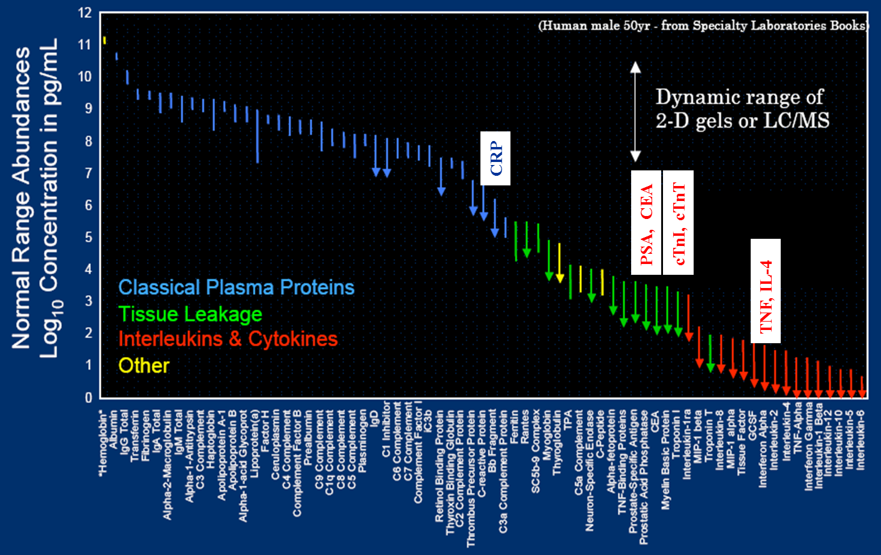
“Interesting” Biomarkers are at Low Concentrations and Masked by More Abundant Proteins
Slide courtesy of N. Leigh Anderson

Slide 13
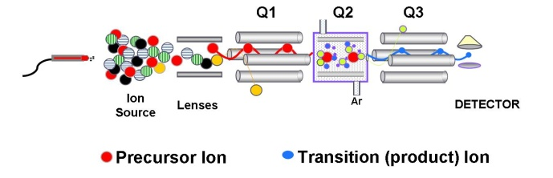
Sample Enrichment and Nanoflow Chromatography Improve Sensitivity in LC-MS
*
*
Protein Sample Cell Lysate Tissue Plasma
Protein-Level
Immunoaffinity Cellular Fractionation
Peptide-Level
IMAC (Phospho)
Immunoaffinity
Fractionation
Quantitative
MRM-MS Method
nLC
Digest to peptides
10-100 uL plasma
10⁷ cells
100’s amol per 1 ug protein (no enrichment)
100’s amol per 1 mg protein (IMAC enrichment)
Sample Enrichment (Plasma) Equivalent Sample Volume
Plasma Depletion (protein level) ~220 nL per inj.
Orthogonal Chromatography (peptide level) ~500 - 1500 nL per inj.
Antibody Enrichment (peptide level) ~100-1000 uL per inj.
1 ug neat plasma (no enrichment)
~ 15 nL
Keshishian et al. (2007) Mol Cell Proteomics; Whiteaker et al. (2007) Anal Biochem

Slide 14
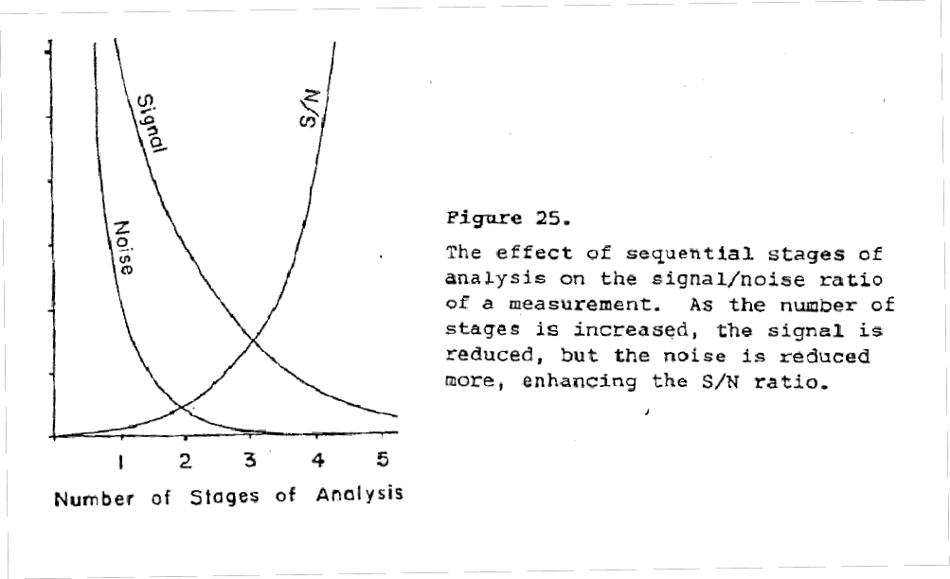
Chemical Noise Interferences: Balancing Signal vs Noise
Modes of separation
2: LC/MS, GC/MS, MS/MS
3: LC/MS/MS
4: Mudpit (LC/LC/MS²)
4: LC/Ion Mobility/MS/MS
Selectivity

Slide 15
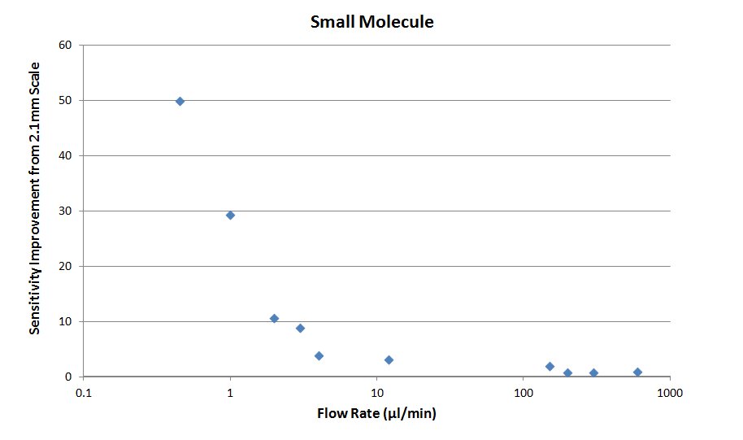
Chromatographic Flow Rate Affects Sensitivity
75µm ID
75µm ID
150µm ID
150µm ID
1mm ID
1mm ID
300µm ID
2.1mm ID
300µm ID
2.1mm ID
Slide courtesy of Jim Murphy, Waters Corporation

Slide 16
Quantitation by MS?!?
Is it even possible….

Slide 17
Quantitation by Mass Spectrometry
…a History
1972: Moore, L.J. and L.A. Machlan. High accuracy determination of calcium in blood serum by isotope dilution mass spectrometry. Analytical Chemistry 44:2291-2296.
1996: Barr, J.R., et al. Isotope dilution-mass spectrometric quantification of specific proteins: model application with apolipoprotein A-1. Clinical Chemistry 42:1676-1682.
1999: Gygi, S.P. et al. Quantitative analysis of complex protein mixtures using isotope-coded affinity tags. Nature Biotechnology 10:994-999.
2002: Ong, S.E, et al. Stable isotope labeling by amino acids in cell culture. SILAC, as a simple and accurate approach to expression proteomics. Molecular & Cellular Proteomics 1: 376-386
2003: Gerber, S.A., et al. 2003. Absolute quantification of proteins and phosphoproteins from cell lysates by tandem MS. PNAS 100:6490-6495.

Slide 18
Quantitation (remember Beer’s Law?)
A = εbc
S = k*c + b
A = signal (absorbance) ε = extinction coefficient c = concentration b = path length
??
S = signal (MS intensity) k = (ionization) coefficient c = concentration b = background signal

Slide 19
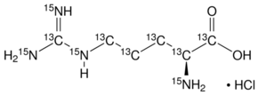
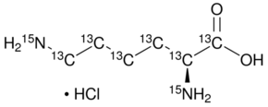
Quantitation by Stable Isotope Dilution MS
Q: Why does this work?
A: Internal Standard shares all characteristics of analyte
– EXCEPT MASS!
¹³C₆¹⁵N₄ Arginine, Δ 10 Da
¹³C₆¹⁵N₂ Lysine, Δ 8 Da

Slide 20
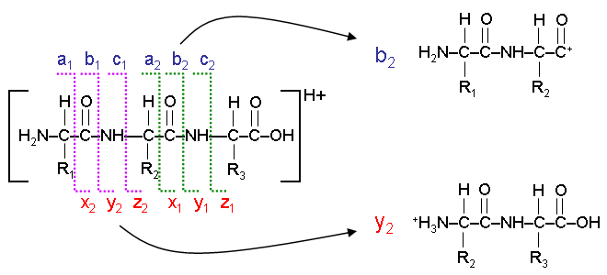
Peptide Fragmentation
Reproducible fragments can be predicted and calculated, based on peptide sequence of amino acids
http://www.alchemistmatt.com/mwthelp/peptidefragmodelling.htm

Slide 21
SID-MS/MS Peptide Example

Slide 22
SID-MS Experimental Design
Digest
Desalt
Protein mixture
Peptides
100
Extract Data
Peak area = ratio
Peak area analyte
80
Δ S
Peak area IS
60
40
20
0
Time (min)

Slide 23
SID-MS Response
Spike fixed amount of heavy-isotope peptide
Vary amount of light-isotope peptide
Plot Ratio of MS response vs Ratio of Amount
Model Experiment
y = 1.0x + b

Slide 24
What do you want to Target?
Empirical LC-MS/MS data
DDA runs from “discovery” samples
Pure protein standards
Synthetic peptides
Protein targets from literature
Potential peptides previously studied by MS
Proteins in pathways of interest
No idea?

Slide 25
Empirical LC-MS/MS Data
Consult the data!
Empirical data are your best starting point
Peptides fragment similarly on different instruments, so use HRAM data as your guide!

Slide 26
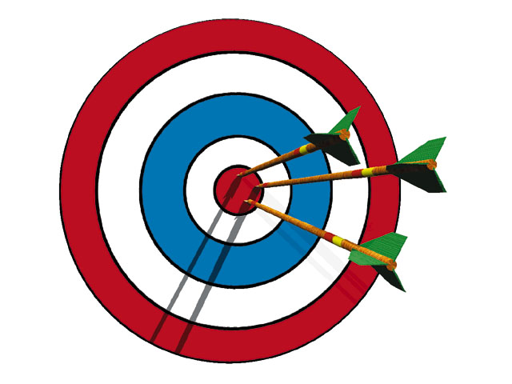
How do I use empirical data from LC-MS/MS experiments?
Search the data against proteomic libraries
Identify peptides with certain confidence
Generate a list of peptides unique to a protein
Target those peptides!

Slide 27
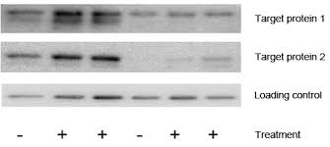

Protein Targets from Literature
“Hypothesis-driven” vs “Discovery-driven”
Data other than MS data point to certain targets
Proteins or protein pathways are indicated
No peptide data
http://www.bio-rad.com

Slide 28
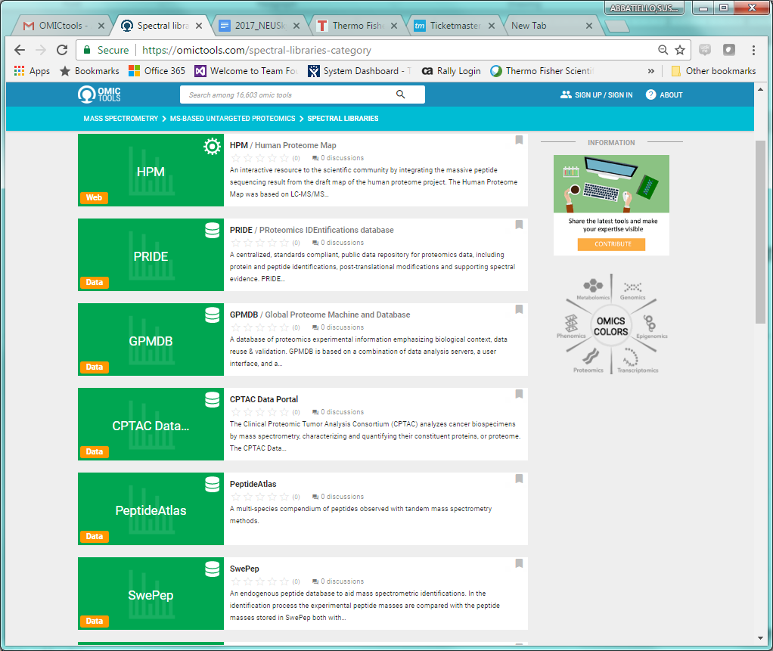
Protein Targets from the Internet!
Consult the data!
Check publicly available databases for empirical results
HPM
PRIDE
GPMDB
PeptideAtlas
SRMAtlas
NISTLibraries
Panorama
Passport
“A month in the laboratory can often save an hour in the library” – Frank Westheimer, Harvard Chemist

Slide 29
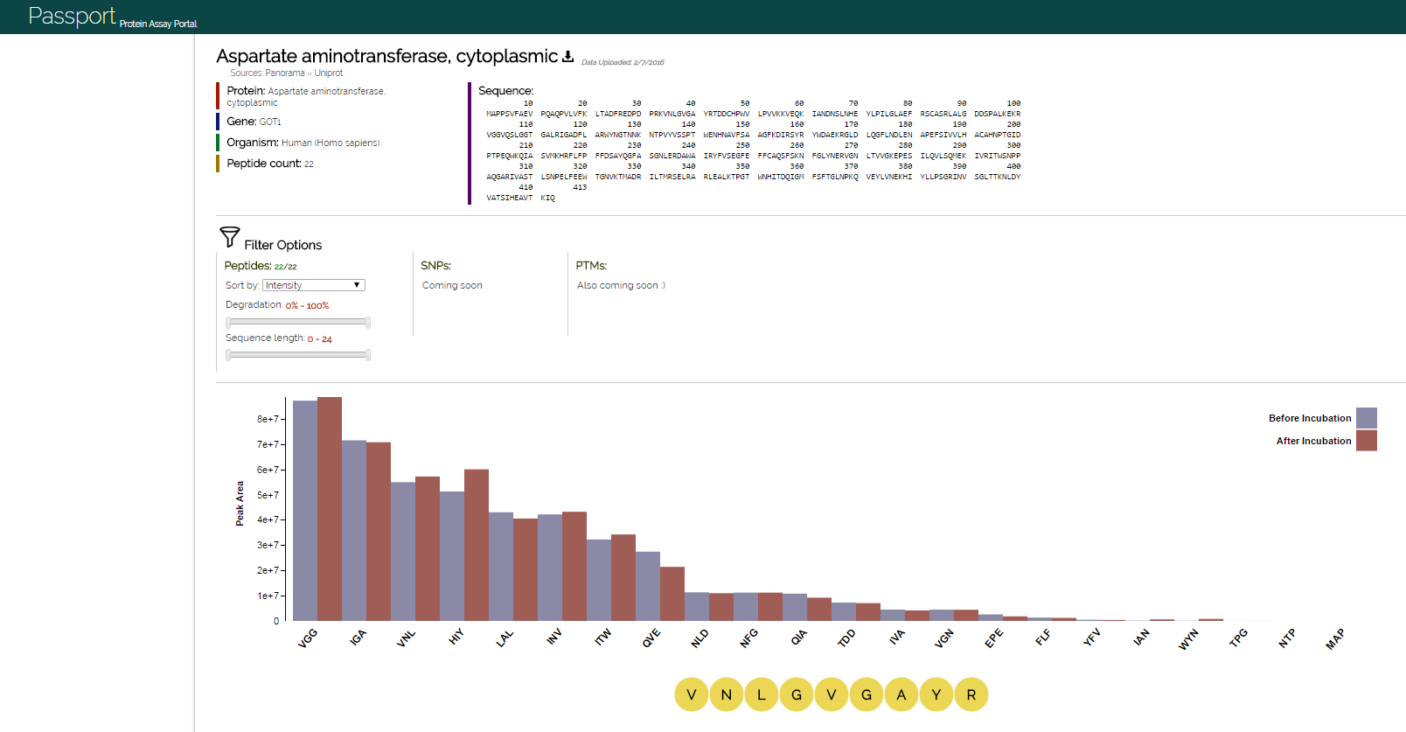
Protein (peptide) Targets from Public Resources: Passport (http://passport.maccosslab.org/)

Slide 30
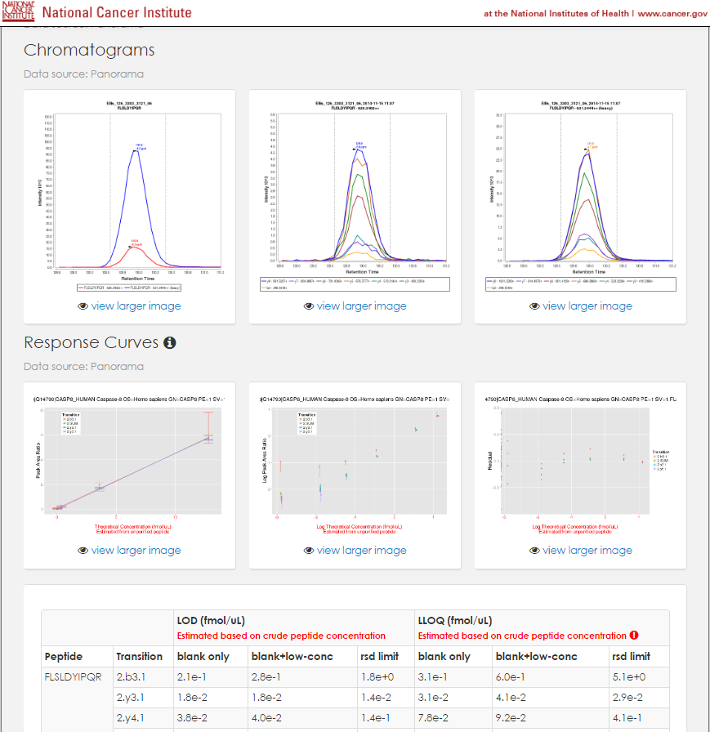
Protein (peptide) Targets from Public Resources: CPTAC Assay Portal (https://assays.cancer.gov)
Assays developed with internal standards
Experimental details
LOD/LOQ
Precision
Repeatibility
https://assays.cancer.gov/CPTAC-795

Slide 31
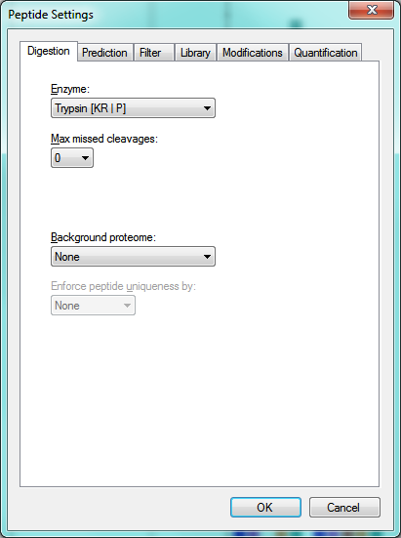
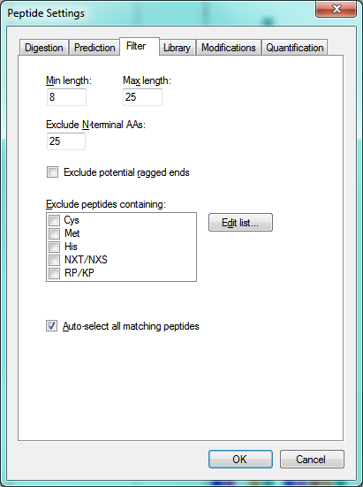
No Idea?
Generate the Data!
Start with general “rules”
Proteotypic peptide
Missed cleavages
Optimal Length
Not close to N-terminus
Exclude labile amino acids
Met (oxidation)
N-terminal Gln (cyclization)
Cysteine (reduction/alkylation)
Beware of PTMs

Slide 32

Examples Using Empirical Data
Q: I have spectral libraries! How do I pick the best peptide transitions?
A: Look at the data!
DDA LC-MS/MS, Database search
Selection of 123 target peptides
SRM or PRM
Spectral Library
Top 8-10 Product Ions
Refined Transition List for
Method Optimization
Selection of best 3-5 ions
CE Calculation

Slide 33
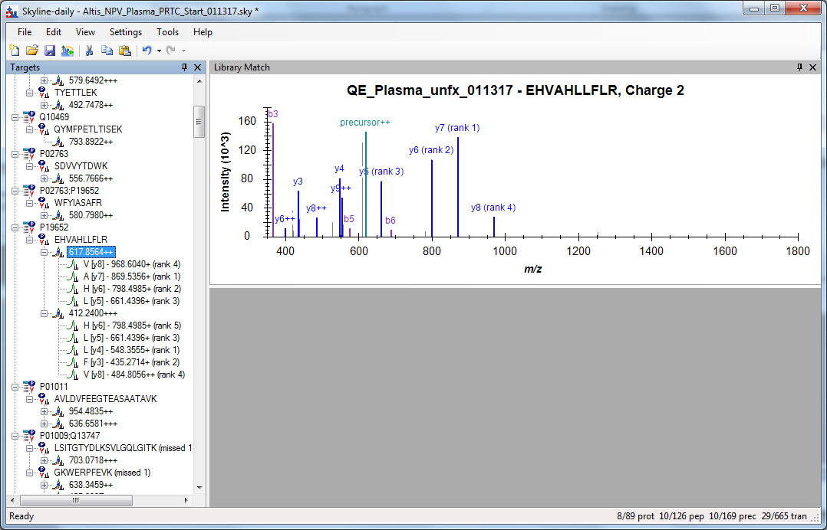
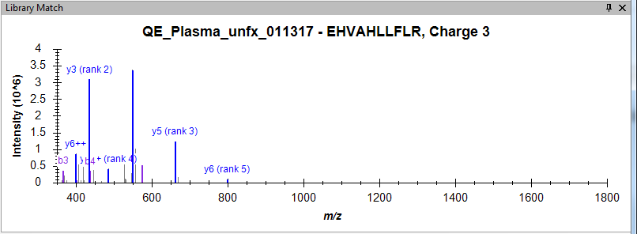
Which charge state do you pick?

Slide 34
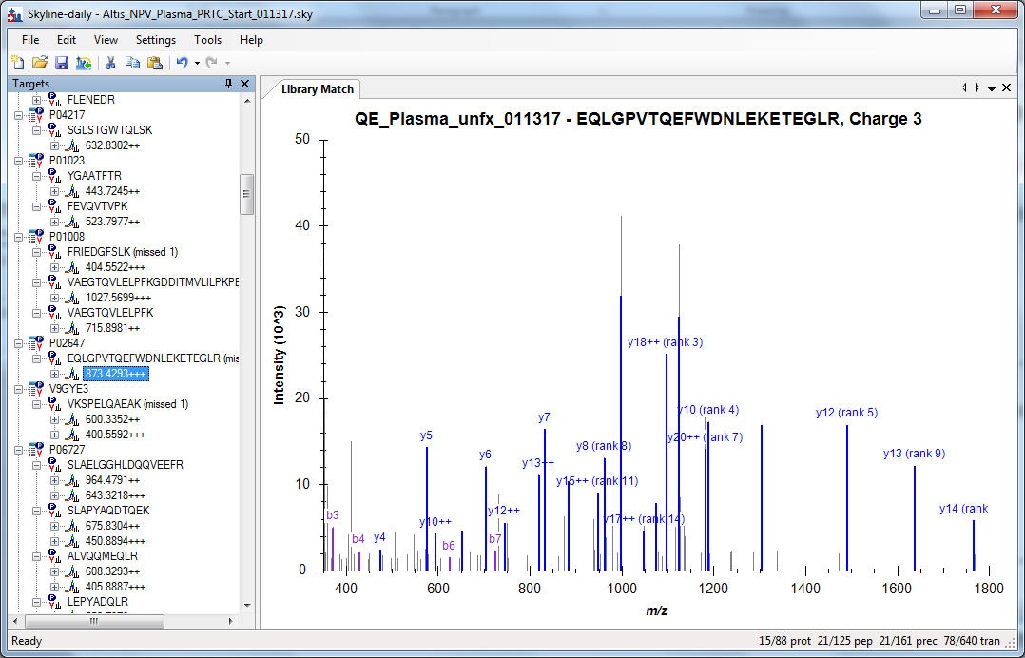
Some peptides are beautiful…

Slide 35
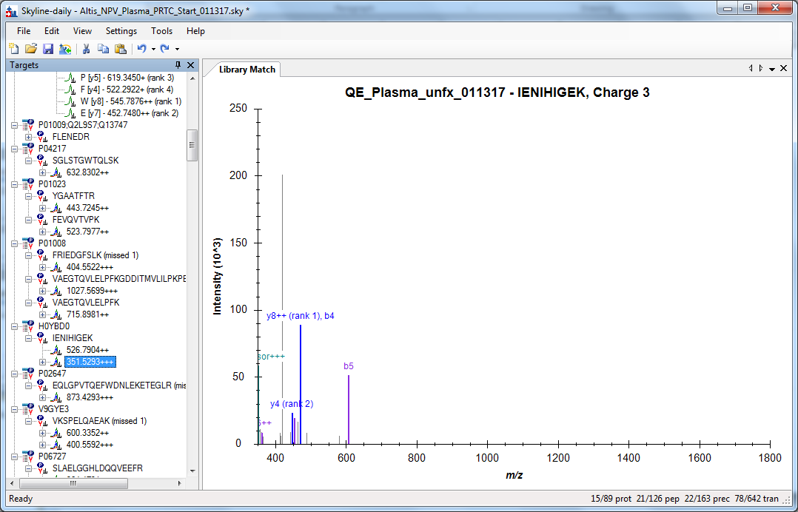
Some peptides are not…

Slide 36








For best results…
Explore the data to understand it.
Use predictions and algorithms as a guide
Check the data manually…you might learn something!
You’ll build experience in generating targeted methods!
You’ll become more confident in your data!
Credit to: Various internet searches for elephants, Mr. Snuffleupagus and chameleons

Slide 37
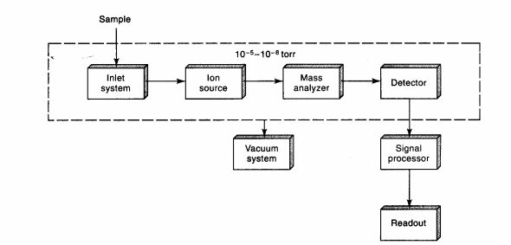
Choices of Mass Spectrometers
Triple Quadrupole or High Res?
(do you have a choice?)
http://people.stfx.ca/tsmithpa/chem361/labs/ms.html

Slide 38
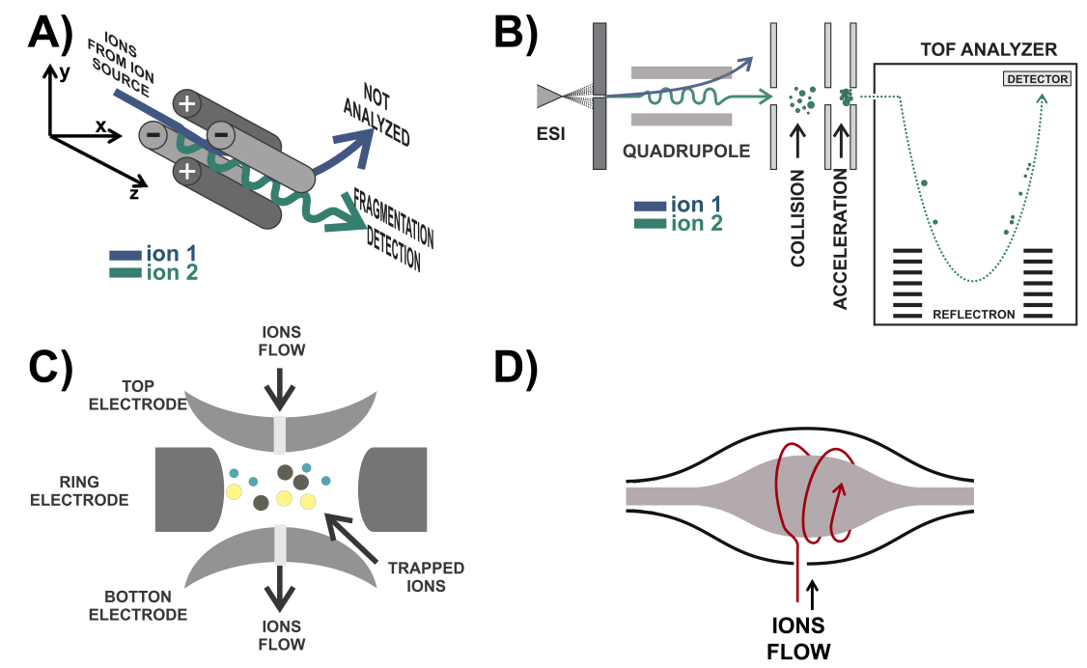
Differences in Mass Analyzers
Low Resolving Power
High Resolving Power
Quadrupole-Time of Flight
QqQ
Ion Trap
FTICR and Orbitrap
https://www.intechopen.com/source/html/44881/media/image2.png

Slide 39
What MS Instrument to Use?
QqQ
HRAM
Low resolution
Nominal mass
Detects product ions on a list
CE optimization possible
Precursors not usually monitored
Lower Cost
200-500 SRMS/sec
~100 peptides (5 SRMS each)
High Resolution
Accurate Mass
Generates all product ions
No CE optimization needed
Precursors can be monitored
Higher Cost
20-100 spectra/sec
~100 peptides

Slide 40
Instrument Cycle Time*
The amount of time it takes to acquire all data points in a given timeframe
Choose based on your chromatography
Aim for 10-15 points across the chromatographic peak
Dwell time (plus overhead/interscan delay) for QqQs
Injection time and detection time for HR
Current QqQs can target ~500 transitions/second (~100 peptides)
Current HR-MS can target 10-50 peptides/sec
Dwell time + “overhead” or “interscan delay”
*Not to be confused with “duty cycle”, which is the percentage of time your instrument is actively producing data.

Slide 41
Where does the time go?
QqQ
Interscan delay: Time to clear quads for next experiment (1-5 msec/transition)
Dwell Time: Time spent monitoring signal from each transition (≥ 1msec/transition)
PREDICTABLE
Independent of ion flux
HRAM
Injection time: Max time to accumulate ions in trap
Detection time: frequency at which data can be detected/transformed (depends on Resolving Power)
NOT PREDICTABLE
Dependent upon ion flux

Slide 42
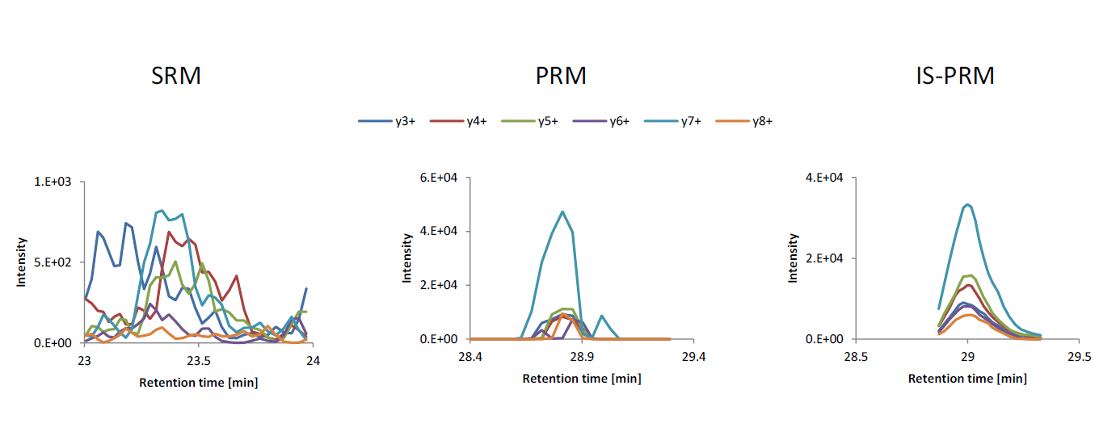
SRM vs PRM vs IS-PRM
Detection is improved by targeted detection during PRM
Ions can be accumulated, offering more sensitivity than SRM
Targeting is real-time, no need for manual scheduling
Gallien, et al, MCP 2015 e-pub

Slide 43
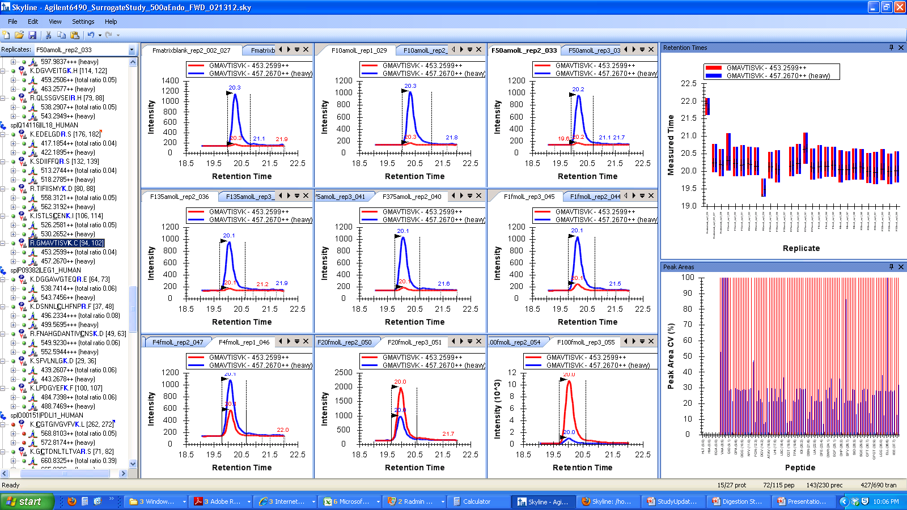
Looking at your Data: Quickly Screen Data in Skyline
Notes:
Idea for rapidly screening large data sets with either many sample files or many peptides.
Panels show a response curve for a peptide (Red) with a heavy-labeled peptide spiked in as the standard (Blue).
Here, RT plots are shown in the upper right and the peak area CV plots are in the lower right.

Slide 44
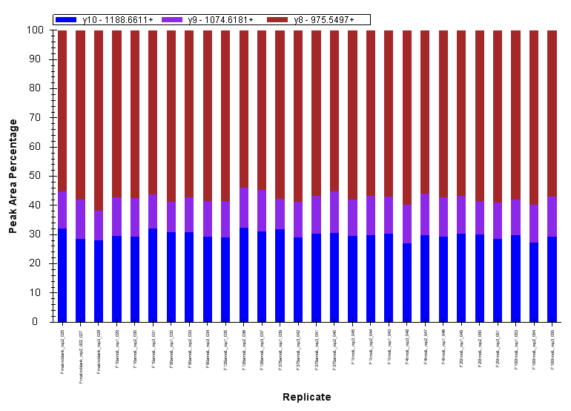
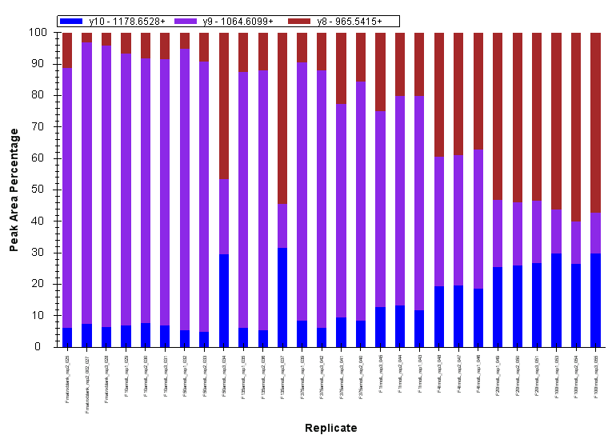
Interference Visualization
Heavy Peptide Transitions
Light Peptide Transitions
Notes:
When the view of the Peak Area plots is changed so that the signal is normalized to 100%, you can quickly observe for interferences.
Here, the heavy peptide has the same signal in all samples, the brown transition having the largest contribution to the overall signal.
When looking at the light peptide (low to high concentration left to right) in this data set, you can see the purple transition is too large, in comparison to the heavy peptide, and it decreases in size as the light peptide concentration increases. This is a quick way to visualize interferences in a response curve or any set of sample replicates.

Slide 45
Standards
Are they necessary?
Peptide or Protein?
What if I don’t have any?

Slide 46
What you might normally see without the IS
Peak Area

Slide 47
What you should see with the IS (same data)
Peak Area Ratio (L:H)

Slide 48
Types of Standards
Labeled Reference Peptide
One or more heavy peptides used for normalization
Global
Addition of heavy-labeled sample of entire proteome (SILAC)
Labeled Synthetic Tryptic Peptides
Isotopically labeled peptides for each target
“Winged” or “Extended” Synthetic Peptides
Contain native amino acids and are spiked pre-digest to account for digestion variability
Heavy Labeled Proteins
Provide

Slide 49
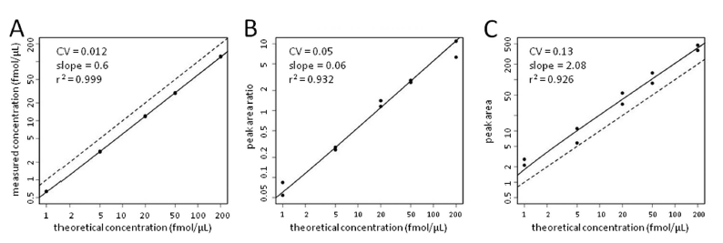
What you might normally see without the IS: Greater Variability
Labeled Reference Peptide
Label-Free no normalization
Internal Standard
While costly, internal standards can compensate for variability in sample preparation and data acquisition, resulting in better precision.
Zhang, H., et al (2011) MCP 10(6):M110.006592

Slide 50
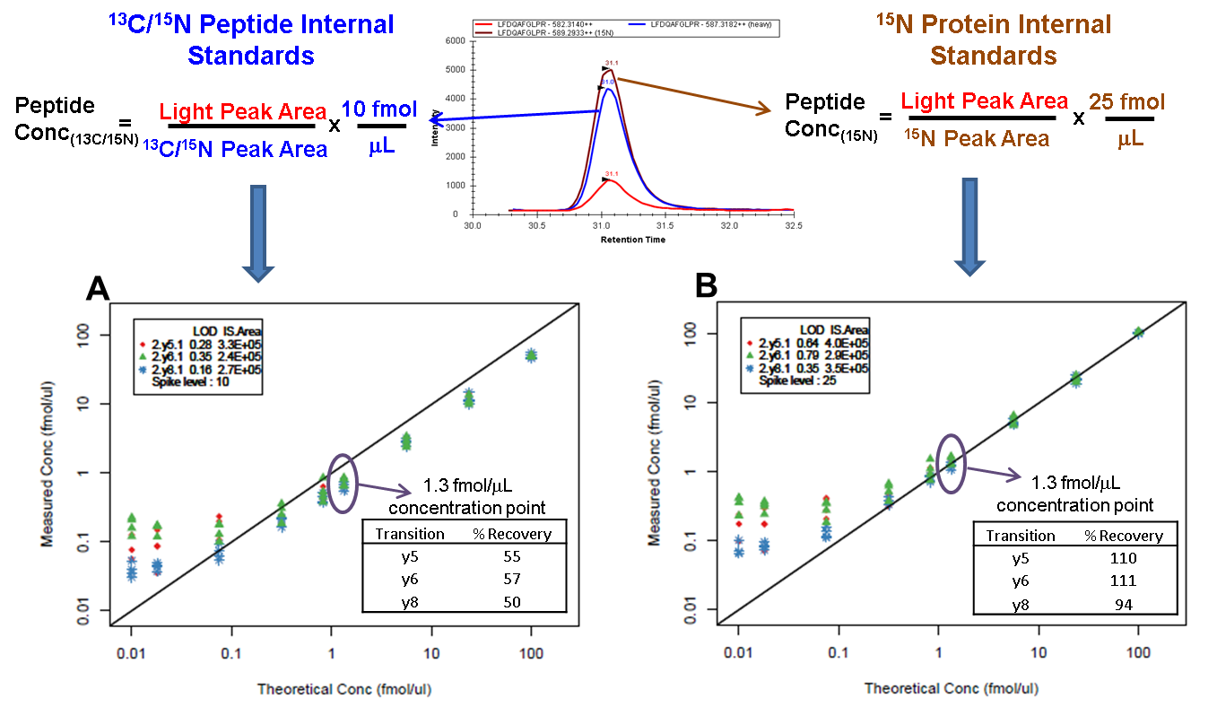
Protein Standards Closest to Ideal: Added early in workflow
Abbatiello, Schilling, Mani, et al, MCP 2015

Slide 51
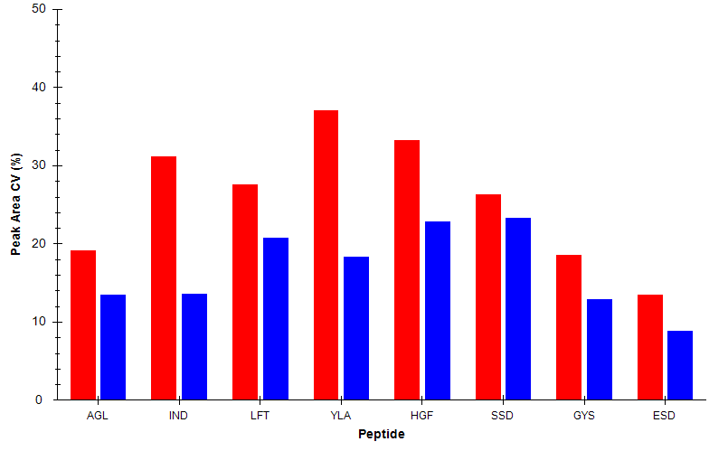
Technical and Process Variability Assessed From Digestion Controls and SIS Peptide Spikes
Raw Peak Area CV assessed over ~150 injections
Process Variability
Light Peak Area from Protein Digestion Controls
Technical Variability
¹³C/¹⁵N Peak Area from post-desalt peptide spikes
Abbatiello, Schilling, Mani, et al 2015 MCP

Slide 52
Targeted Assay Optimization
Denaturation
Peptide selection
Cycle Time
Digestion
Chromatography
What should you spend your time on?
IS Spike Level
Desalting
Transition selection
Collision Energy
Dwell Time/ Injection Time
Retention Time Scheduling

Slide 53
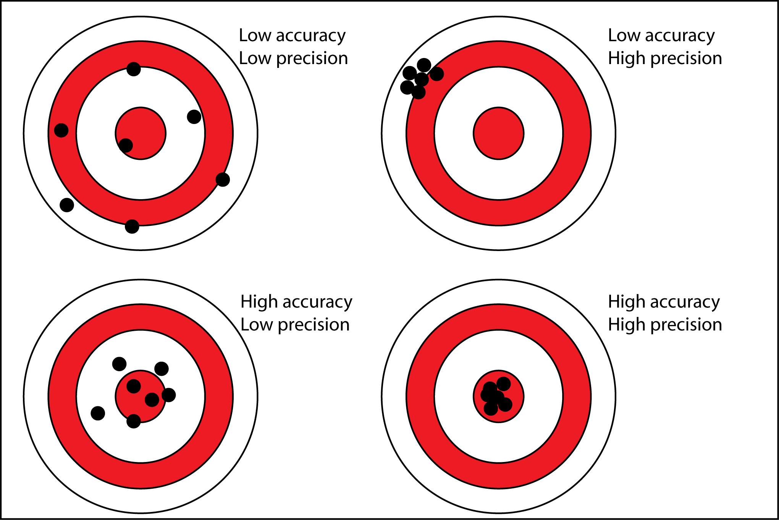
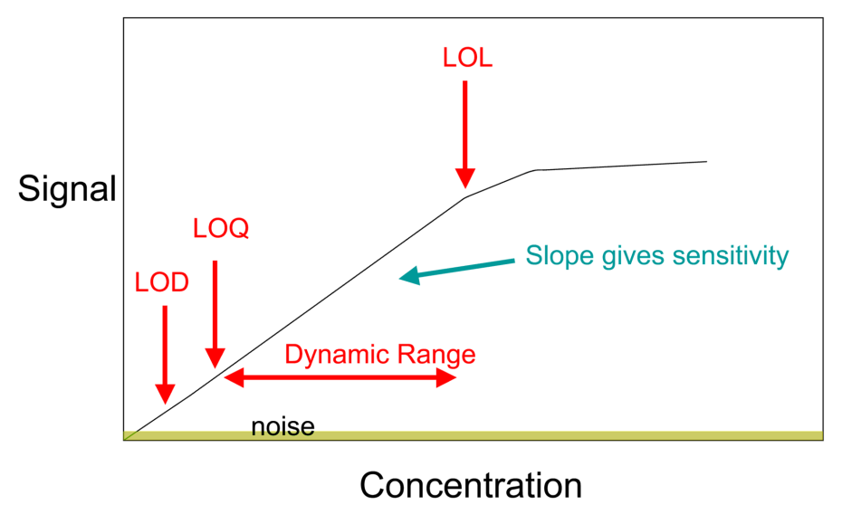
Key and Important Aspects to Targeted Peptide Methods
Reproducibility (Precision)
Accuracy
Sensitivity
Robustness
Dynamic Range
https://sites.google.com/a/apaches.k12.in.us/mr-evans-science-website/accuracy-vs-precision
https://en.wikipedia.org/wiki/Calibration_curve#/media/File:Calibration_curve.png

Slide 54
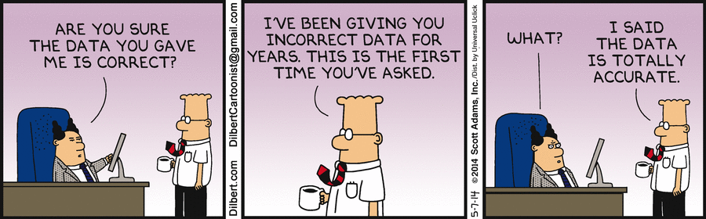
Summary
Consult the Literature!
Generate data!
Review those data!
Evaluate if the data make sense!
Repeat!

Slide 55
Introduction to Skyline
Brendan

